Slide 1


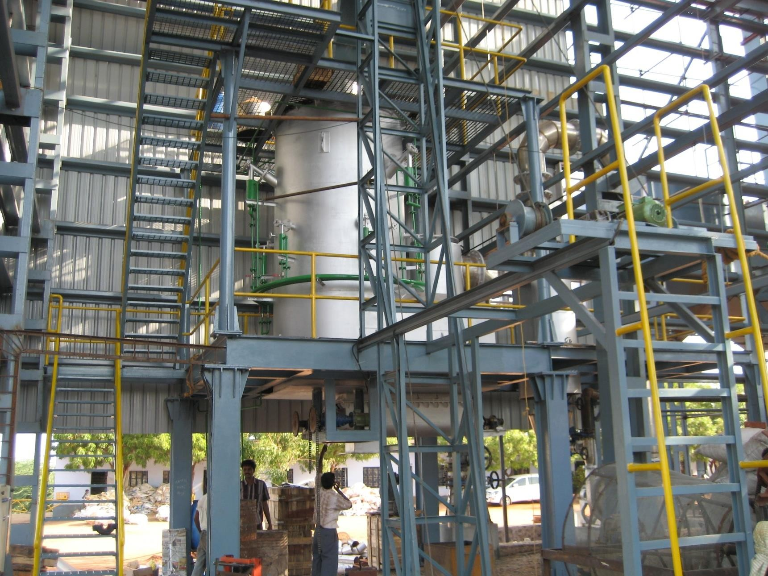

Slide 2
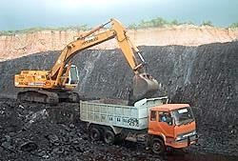
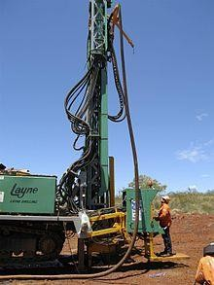
Go Green – Save the Earth reduce Global Warming
Fossil Fuels are limited and will exhaust any time....
Coal, Crude

Slide 3
Take responsibility –
Corporate Social Responsibility simply by
Industrial Fuel Switching
from Fossil Fuels...
(Coal, Crude)
to
Renewable energy.
Renewable energy can be used again and again and will never run out.
Wind, Solar, Hydro, Garbage, Biomass

Slide 4
Renewable energy
Definition
Derived from resources
that are naturally regenerative or are practically inexhaustible, such as biomass, heat (geo- thermal, solar, thermal gradient), moving water (hydro, tidal, and wave power), and wind energy.
Municipal solid waste may also be considered a source of renewable (thermal) energy.

Slide 5
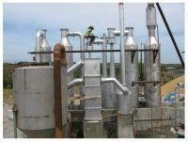
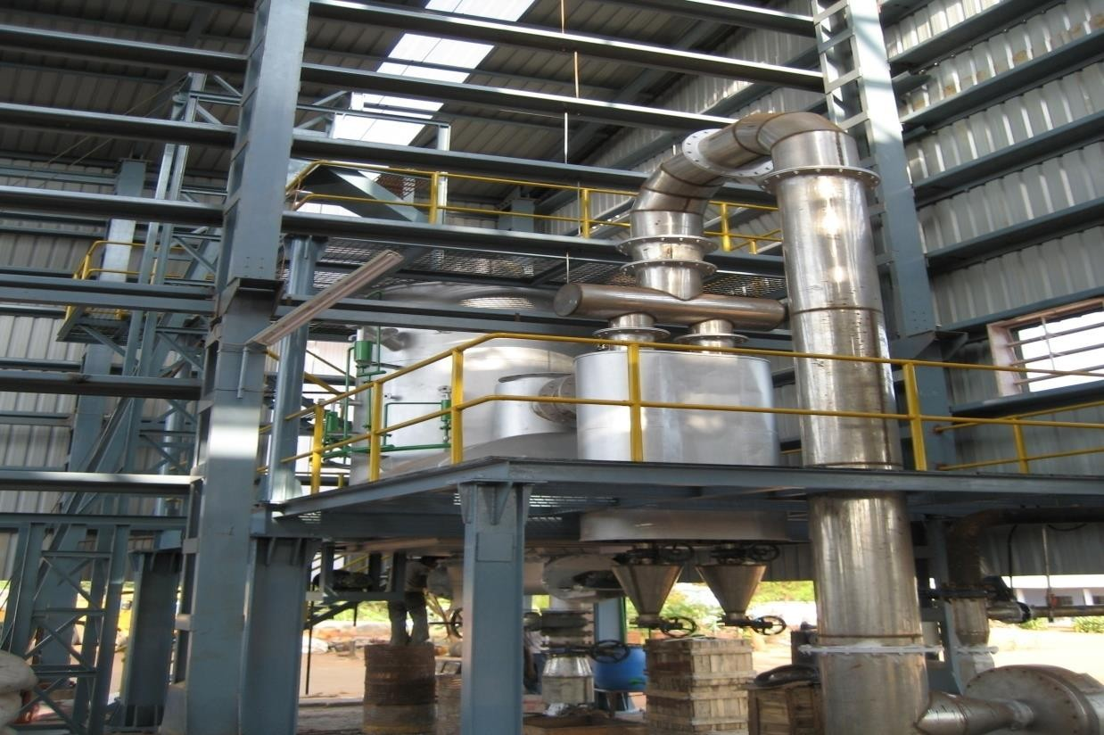
Biomass

Slide 6

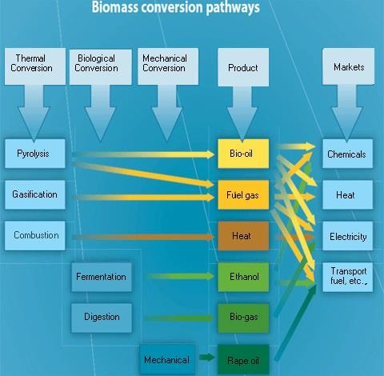

Slide 7
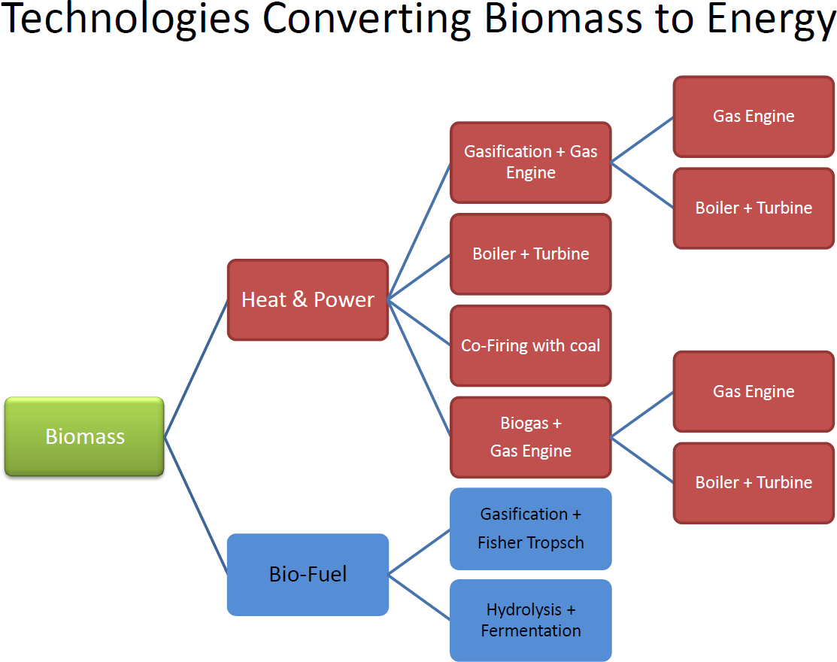

Slide 8


Slide 9
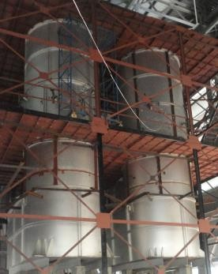
What constitutes Biomass…?
Agri waste like Rice/Oat Hulls, Rice Straw Chicken/Turkey Litter
Tree waste and Saw Dust

Slide 10
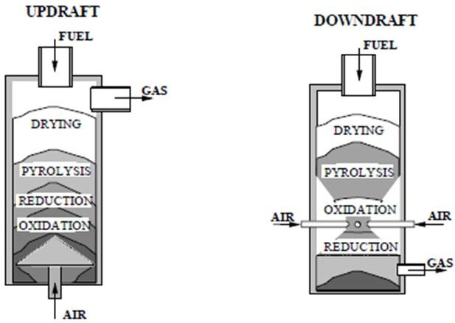
Types of Gasifiers…

Slide 11
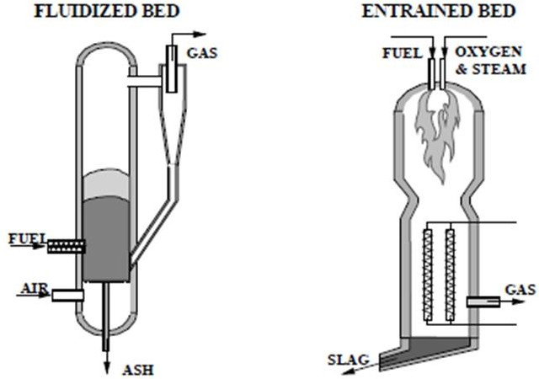
Types of Gasifiers

Slide 12

Biomass Gasification is the process of conversion of solid biomass to gaseous form by partial pyrolysis, oxidation and reduction under sub-stoichiometric conditions.

Slide 13
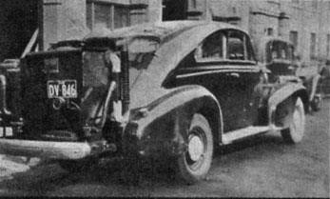
Composition of Producer gas
H₂ (18-20%)
CO (18-20%)
CH₄ (<3%)
CO₂ (8-10%)
and balance N₂

Slide 14
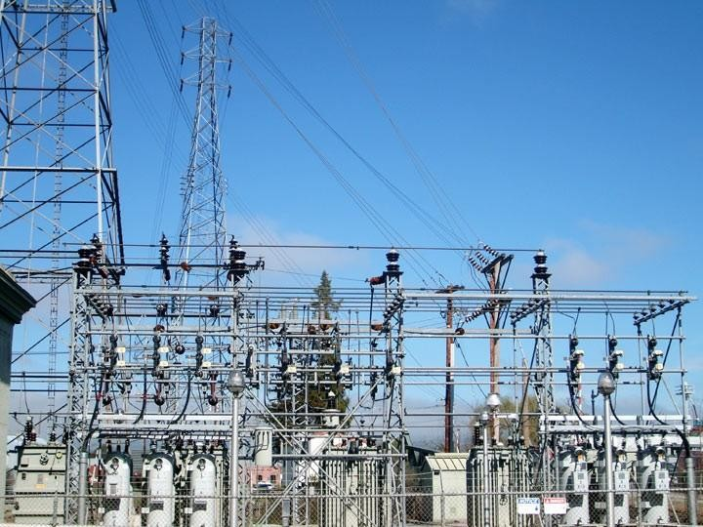
Producer gas
can be used for :
Thermal Applications
Power Generation and/or
Combination of Heat and Power

Slide 15

Thermal Applications
To replace Diesel/FO/ HFO/LPG in:
Kilns
Dryers Furnaces
Boilers & Thermal Heaters

Slide 16
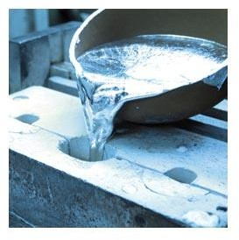
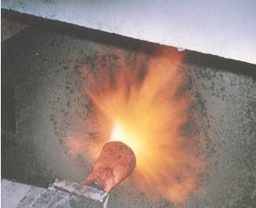
Thermal Applications
Typically used in melting Iron, Steel, Magnesium Chloride & Lead

Slide 17
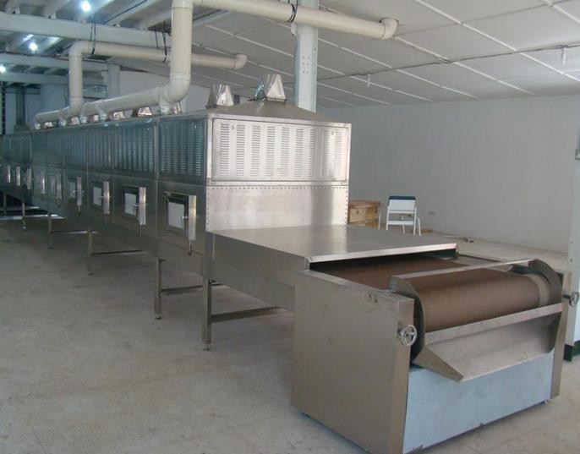
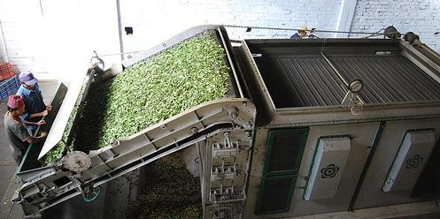
Thermal Applications
Heat treatment furnace, Crumb rubber preparation, Biscuit Furnace, Tea drying and fluidized bed driers

Slide 18
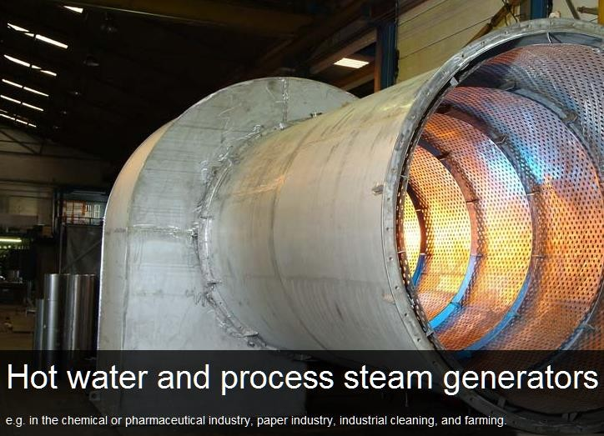

Slide 19
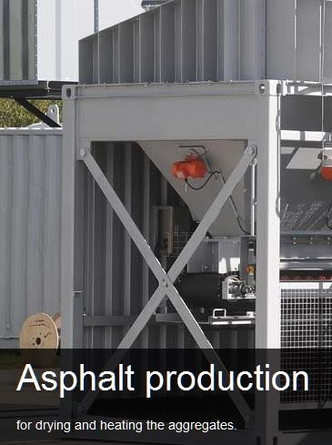

Slide 20
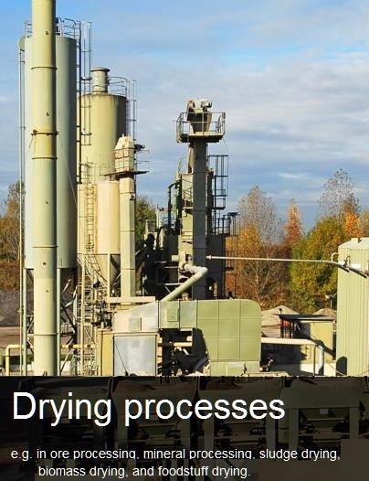

Slide 21
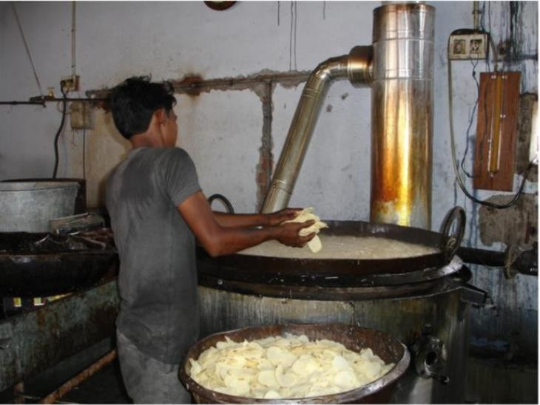
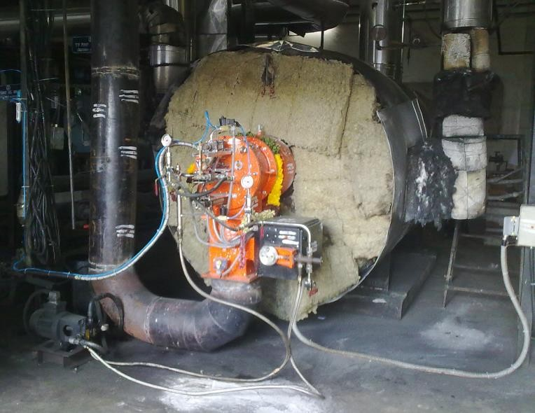
Chips Production
Bakery

Slide 22
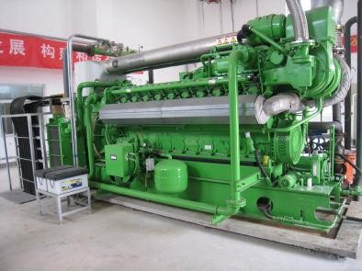
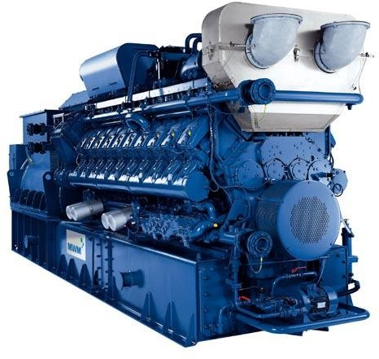
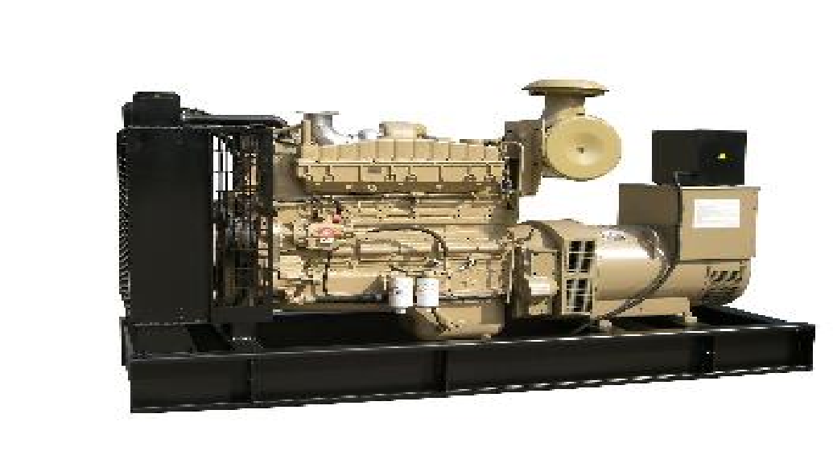
Power
Producer gas can be used in 100% Gas Engines and/or modified Diesel Engines in dual fuel mode (80% Producer Gas : 20% Diesel)

Slide 23

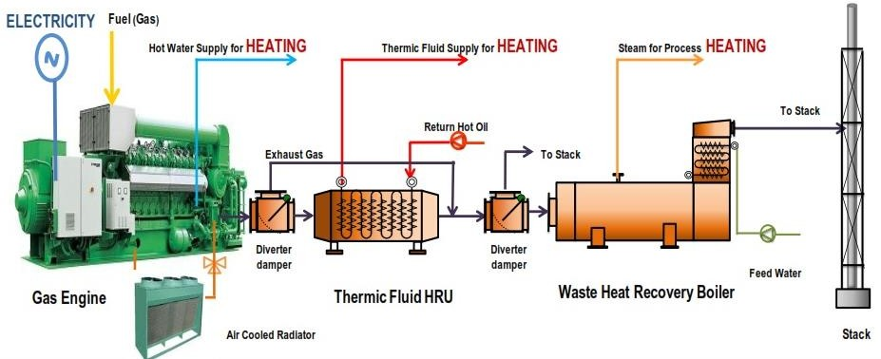

Slide 24
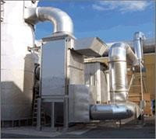
Combination of Heat and Power
Flue gas available from the engine
and engine jacket water can be recovered to a direct fired VAM

Slide 25
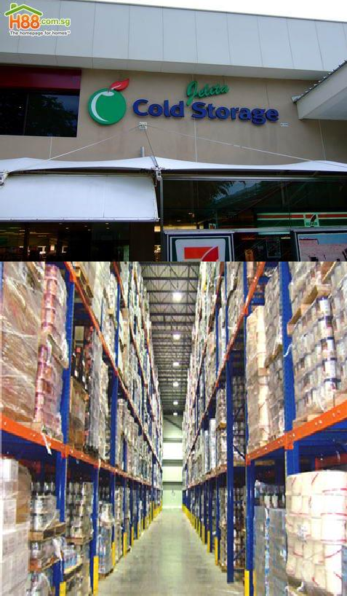
for applications in

Slide 26


Air conditioning
Malls Multiplex

Slide 27
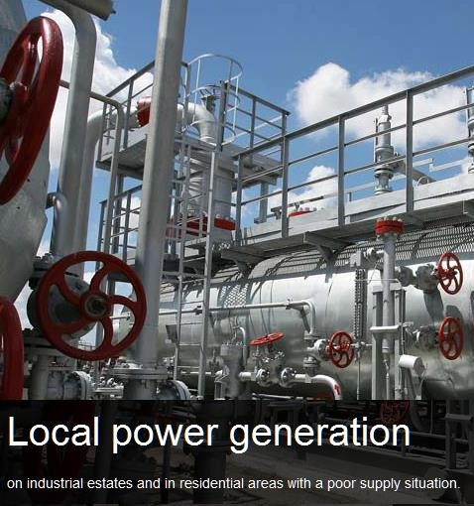

Slide 28
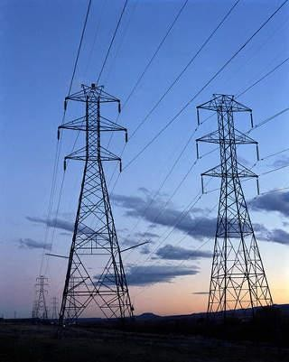
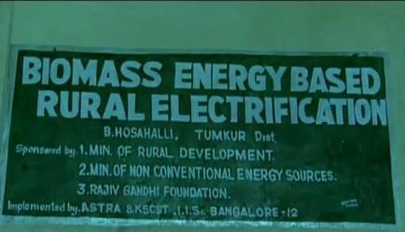
Biomass Gasifier based power plants can be built from 25 kW to 3 MW optimally.

Slide 29
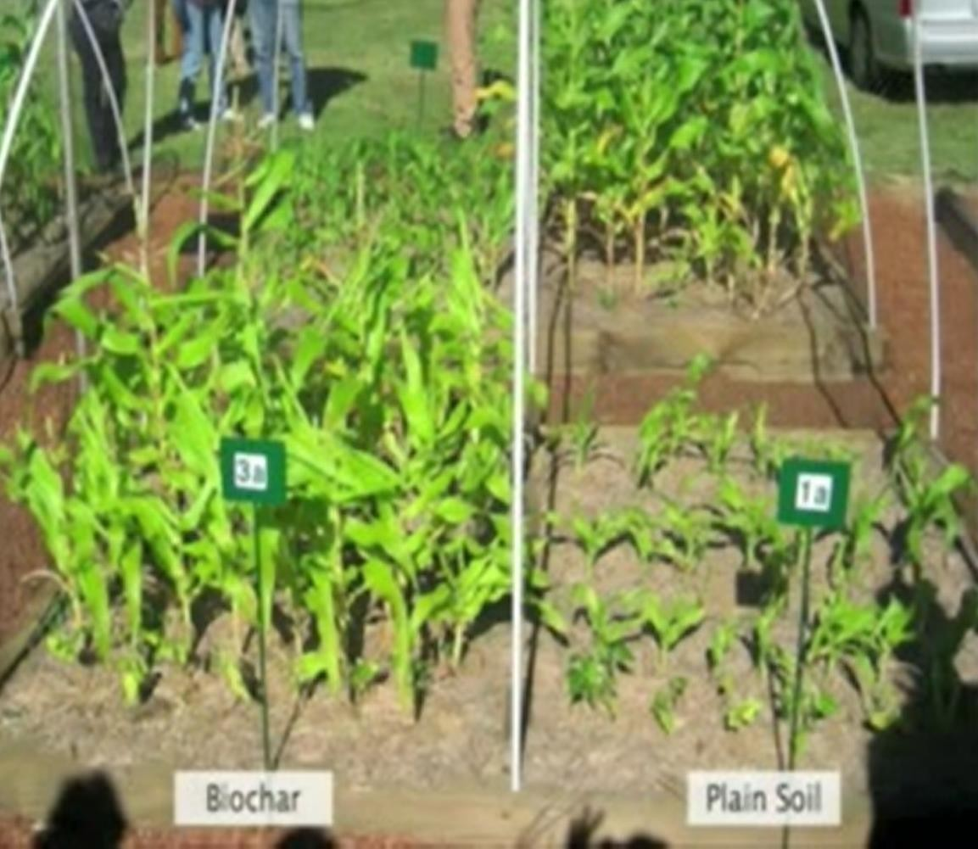
Bye Product Bio char is being touted for soil improvement and carbon sequestration.

Slide 30
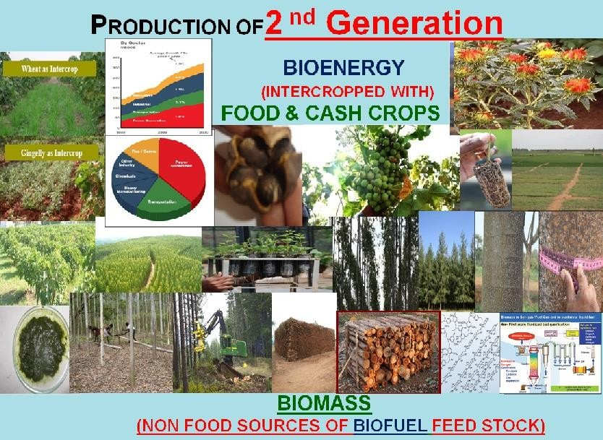
Is there enough Biomass.?

Slide 31

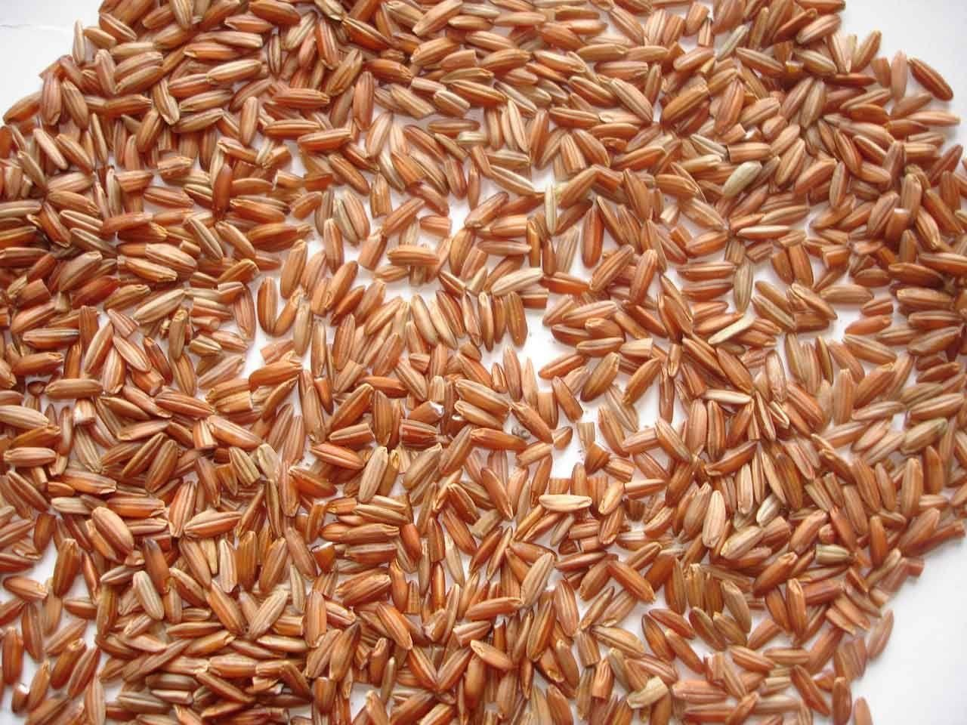

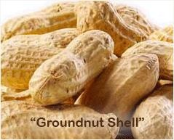
Rice Husk

Slide 32
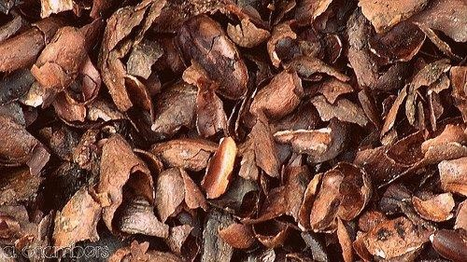
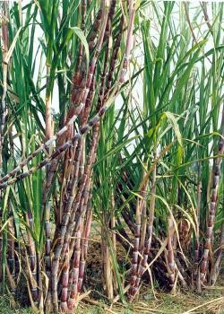

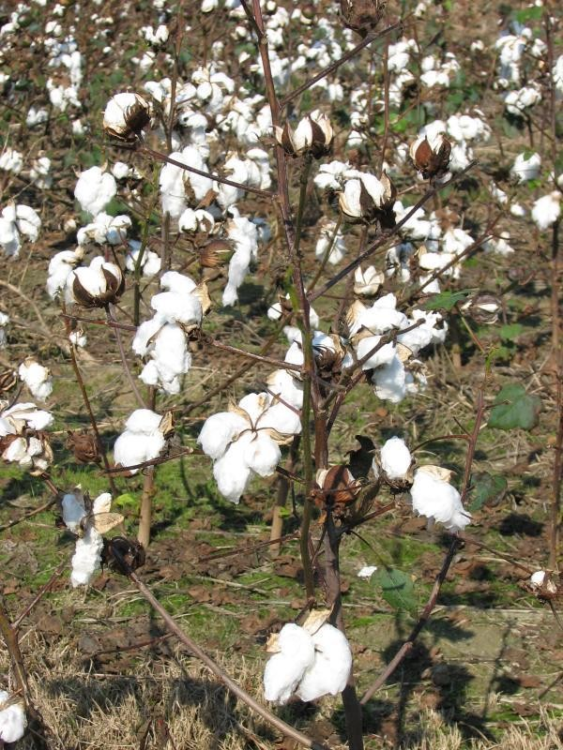
Sugar Cane Bagasse Trash
Cocoa Shell
Coffee Husk
Cotton Stalk

Slide 33





Slide 34

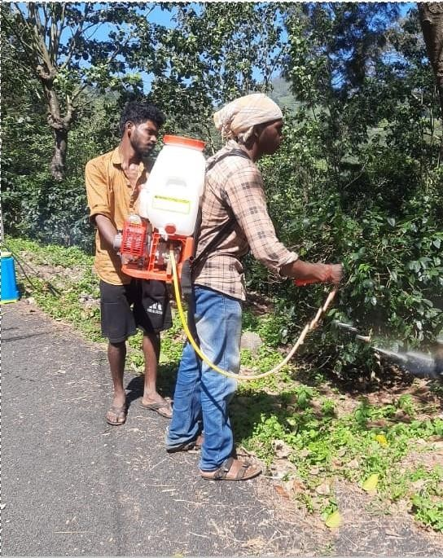
Plantation Prunes
Tea Coffee
Cardamom Pepper Wines

Slide 35
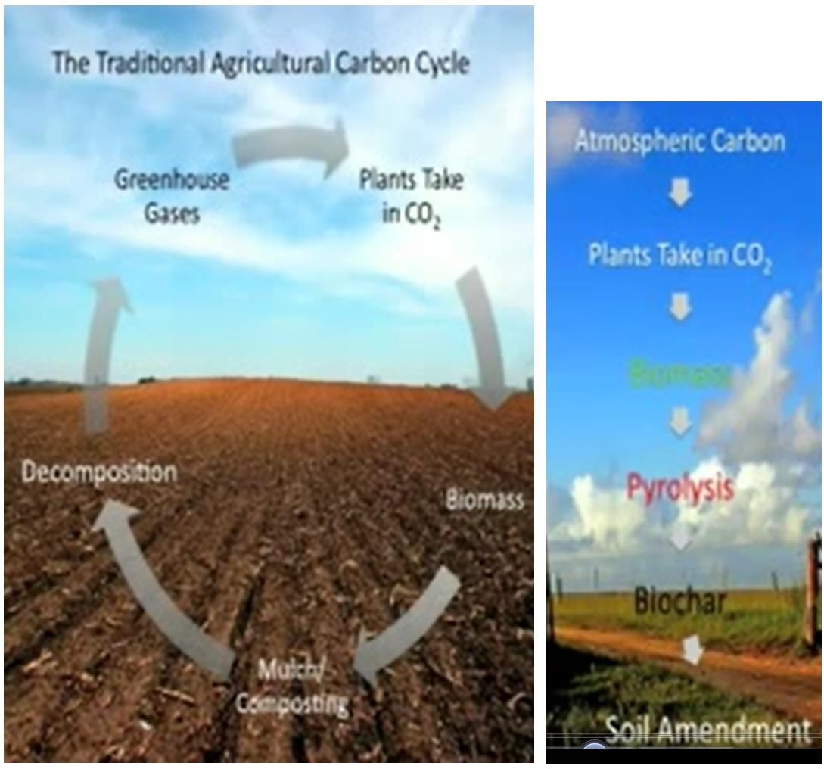
Re-Char Concept

Slide 36


Come let's Go-green and contribute to reduce Global Warming and ensure that we bequeath a clean Earth to our future Generation

Slide 37


Cell: email: Website:
+91 9444019231/ Chandra Mohan vcmohan@gmail.com
www.acclaimcleanenergy.com

