Slide 1

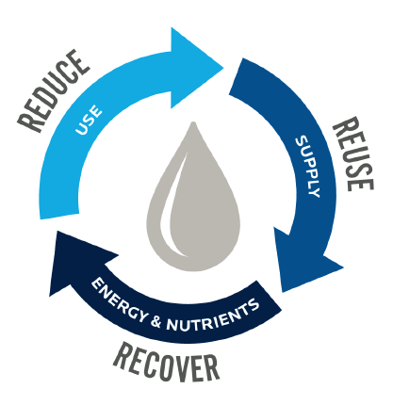
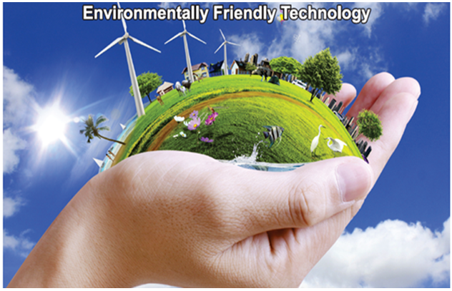
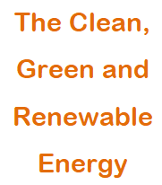
Bio Energy from
Notes:
Welcome to this presentation on how to convert Waste to Value. Nothing is waste until wasted. In this session we will be discussing how to convert biodegradable waste like Kitchen, Food, Plant, Animal and human waste to energy in an environmental friendly way. Biogas is a clean, green and renewable energy.

Slide 2
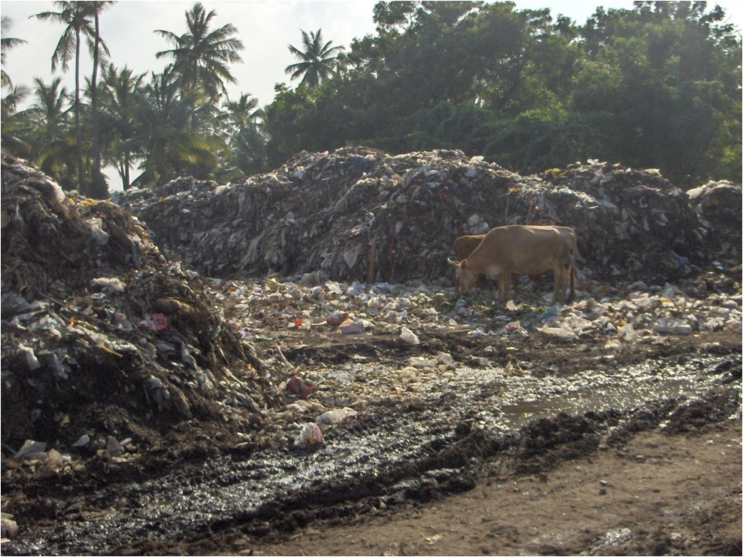
Stone AGE, Bronze AGE, now Garb AGE.
Dump yards are the main cause
of Water, Air and Land Pollution
Notes:
We have come through stone age and bronze age to garbage. Garbage today is not handled scientifically leading to water, air and land pollution from land fills.

Slide 3
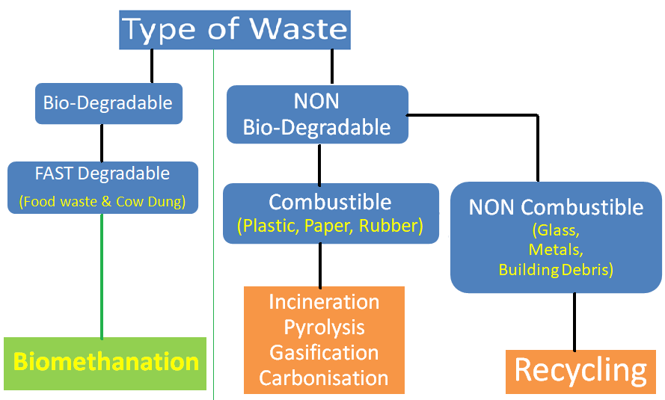
Notes:
Waste can be segragated into Biodegradable and Non-Biodegradable. The Biodegradable waste can be converted into Biogas and used for thermal applications like cooking, heating, etc. The Combustible waste like Plastic Paper & Rubber, which can be burnt or carbonised and the energy used to generate power or thermal energy or combined heat and power based on need. The non-Combustibles can be segregated and recycled.

Slide 4
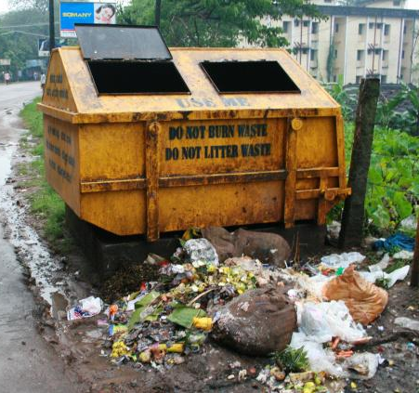
Waste-2-Value Concept
Solid waste
generated per
capita
per day = 0.40 kg
Sewage waste
generated per
capita per day = 150 ltr
Notes:
The average waste generated in per capita is estimated as 400 grams/day and sewage 150 ltr/day. In an urban area this adds up to unmanageable volume if not planned to be disposed of scientifically. Chennai generates around 3,500 Tons of Garbage/day.

Slide 5
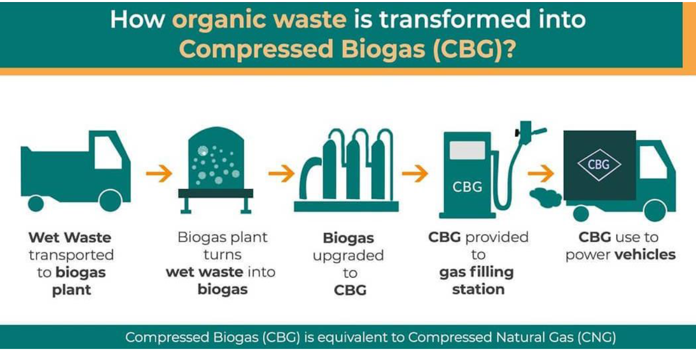

Slide 6
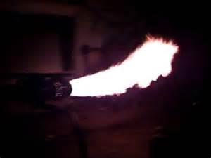
Biogas composition
Mixture of
Methane (65 to 70%)
CO2 (30-35%)
H2S
H2O &
Traces of
H2
O2
N2
Biogas does not contain Sulphur,
so it is considered as clean fuel.
Notes:
The gas is primarily Methane (65 to 70%) and Carbon Dioxide (30 to 35%). Biogas does not contain Sulphur and hence it is considered a Clean Fuel. Biogas can safely used in thermal applications like

Slide 7
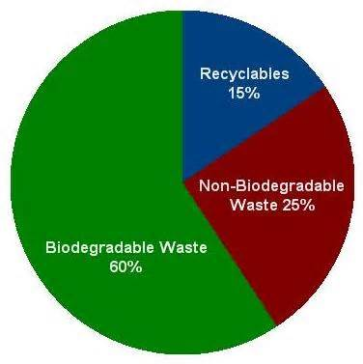
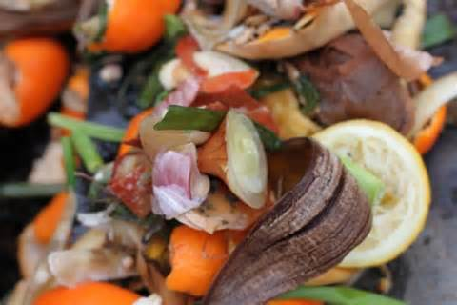
What is Degradable Waste
Biodegradable waste is that which can be broken down, into its base compounds by micro-organisms and other living things.

Slide 8
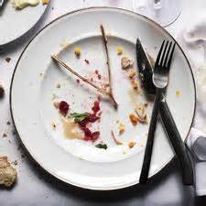
Source of Fast Degradable waste
Food Waste –
remains of balance of cooked food, wasted food, decayed food

Slide 9
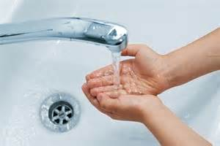

Source of Fast Degradable waste
Water waste –
from vessel cleaning, washing vegetables and grains, plate wash, hand wash

Slide 10
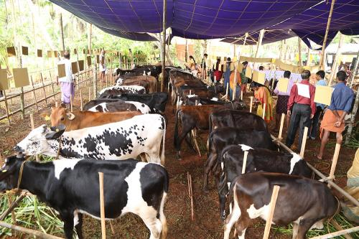
Source of Fast Degradable waste
Animal waste
Cow dung, Chicken/fish litter

Slide 11

Source of Fast Degradable waste
Human waste
Stool & urine
(chemical free flushing should be ensured, else it will destroy the bacteria that aids digestion)

Slide 12


Source of Slow Degradable waste
Agri waste –
grass and garden trims, dry leaves, saw dust, rice husk…
Whether Commercial Crop or Food Crop only
<30% is useful product the rest is wasted.
This waste is a resource which we are destroying by burning or mulching contributing to Global Warming.

Slide 13

Source of Slow Degradable waste
Waste paper –
Should be shredded and mixed with cow dung

Slide 14
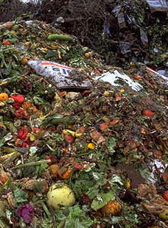
Source of Mixed Degradable waste
Municipal Solid Waste (MSW)
Bio-degradable waste segregated from MSW

Slide 15
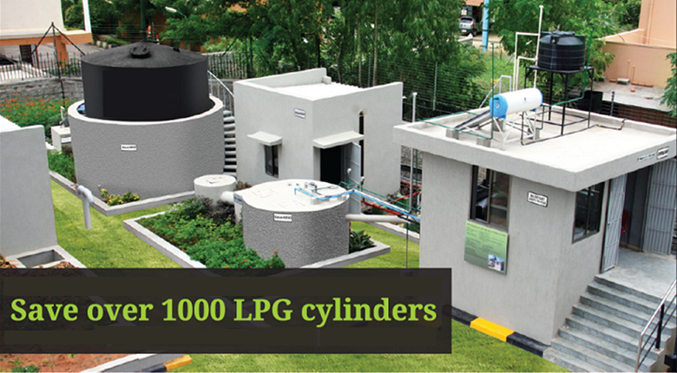
Did you know 1 Ton of waste generated/day can save up to
1,000 Commercial cylinders of 19 kg/year. What a waste of resource
Notes:
Acclaim Green Bio is BARC Patented Twin Digestor technology that is proven and time tested. Around 50 kg LPG equivalent gas is generated/day for an input of 1 TPD.

Slide 16
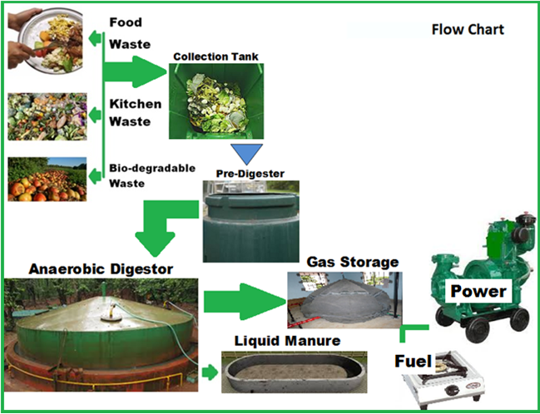
Flow Chart
Notes:
The Biodegradable waste is crushed and hot water added to make it into a homogeneous material and transferred to a pre-digestor by gravity. The pre-digestor aerates and prepares the homogenous waste for biological degradation

Slide 17
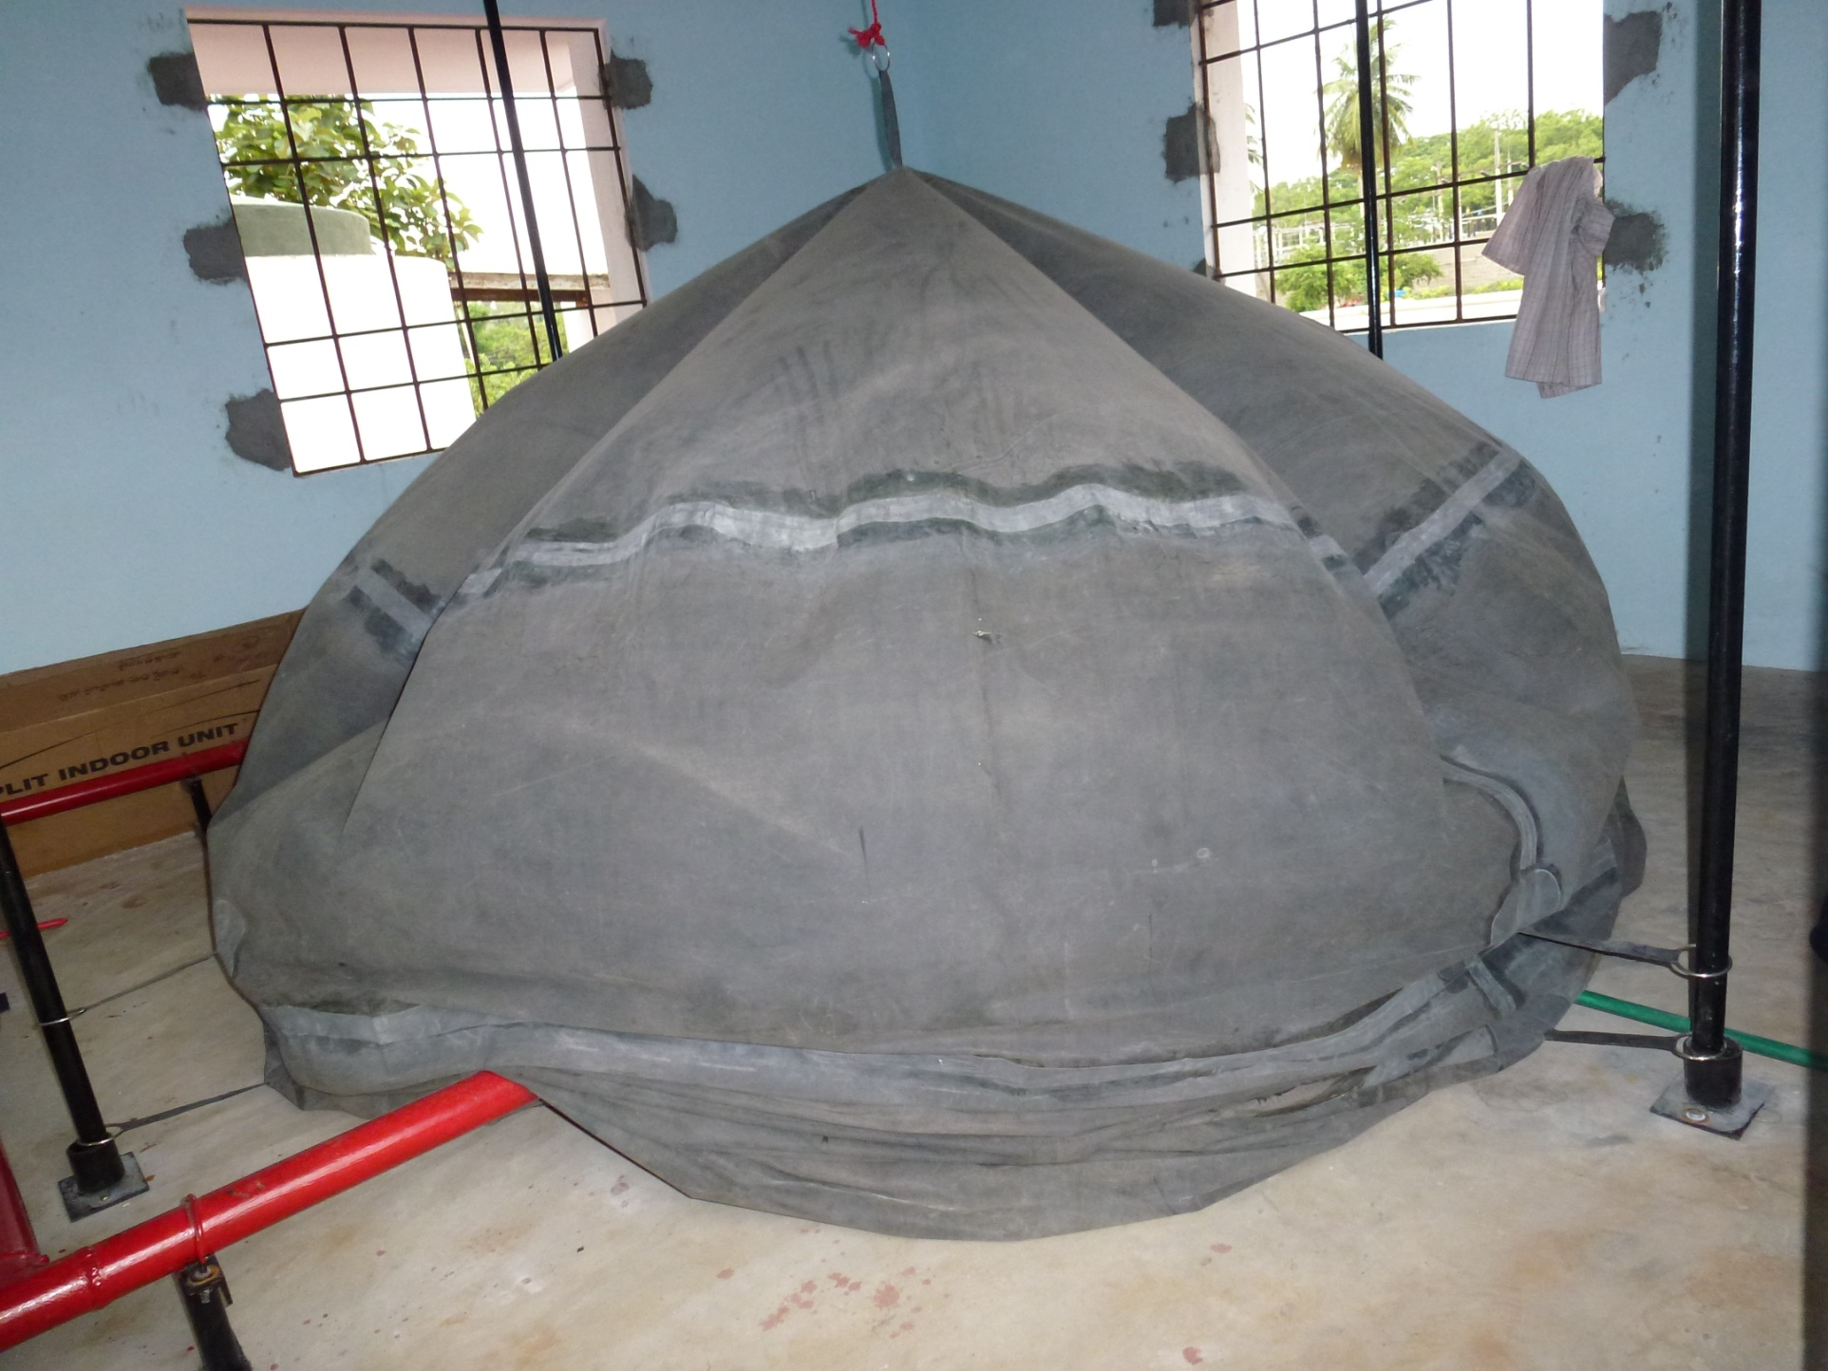
TNPL Kitchen/Food waste to Energy Plant - 500 Kg/day
Gas Balloon
Notes:
A gas balloon is provided to store the gas and use as and when need arises.

Slide 18
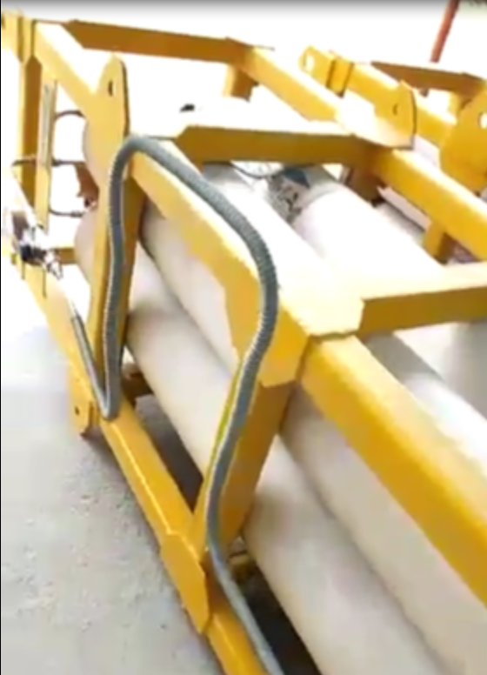
Biogas sans impurity is bottled in Cylinders. Normally 12.5 kg is filled in each Cylinder. 4 cylinders is encompassed in a Cascade. This is for ease of filling, handling and transport.
Compressed Bio Gas
Notes:
The gas is primarily Methane (65 to 70%) and Carbon Dioxide (30 to 35%). Biogas does not contain Sulphur and hence it is considered a Clean Fuel. Biogas can safely used in thermal applications like

Slide 19
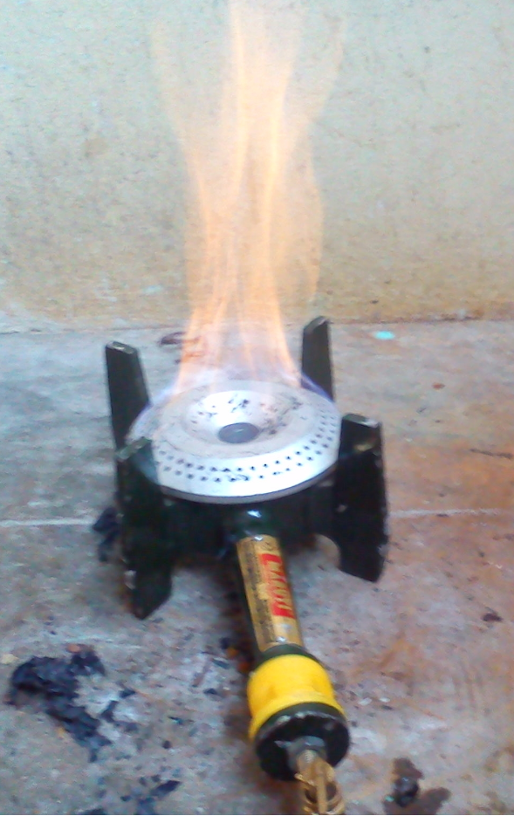
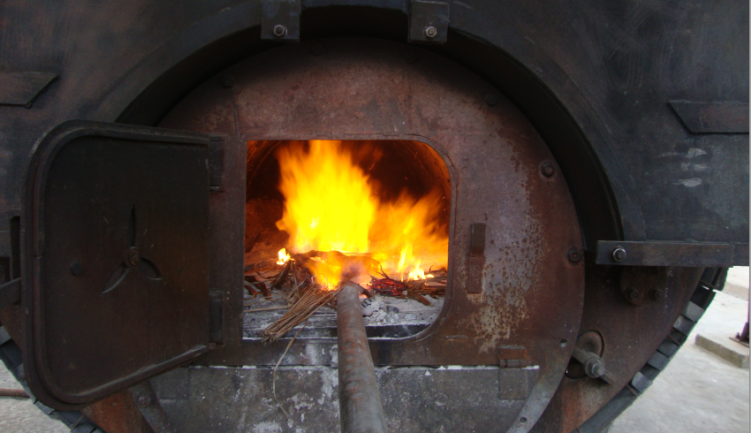
Bio Energy Application
Heating
Notes:
Heating in boilers

Slide 20
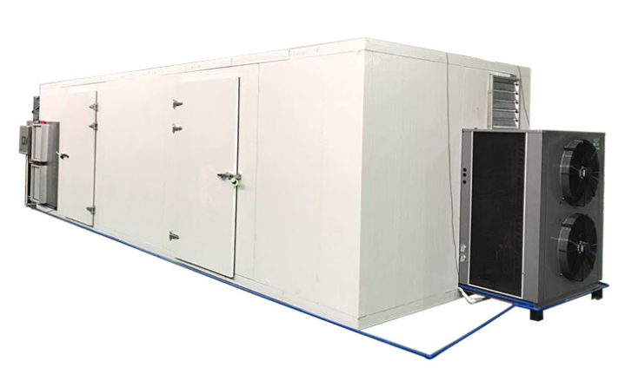
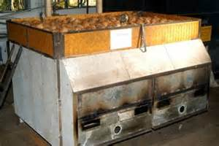
Bio Energy Application
Drying
Copra drying
Notes:
Drying

Slide 21
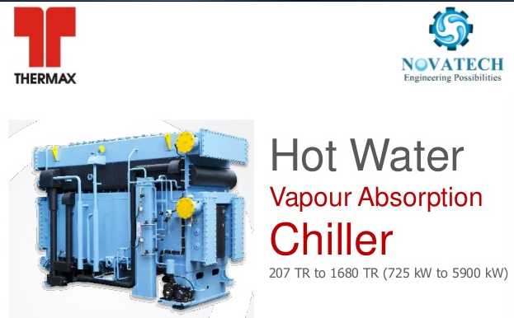
Bio Energy Application
Chilling/
Air-conditioning
(using VAM)
An absorption chiller is different to other chillers because it doesn’t have a compressor. Instead it uses heat to generate cooling.
Notes:
Chilling or Airconditioning using Vapour adsorption machines.

Slide 22
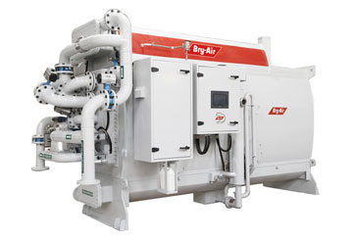
Bio Energy Application
Chilling/
Air-conditioning
(by Adsorption chiller)
Adsorption technology is new and environmentally friendly. These systems can use low quality waste-heat for cooling production in different residential and commercial buildings. They can also be used in conjunction with absorption chillers if there are heat sources with different qualities. In adsorption chillers, the refrigerant water is adsorbed on a solid sorbent like silica gel or zeolite during disposal of latent heat on the surface.
(1,000 m3 of raw biogas replaces approx 400 kg of LPG)
Notes:
Chilling or Airconditioning using Vapour adsorption machines.

Slide 23
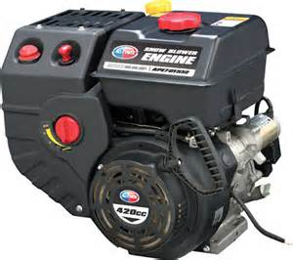
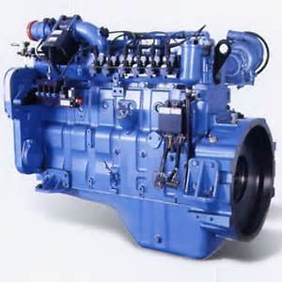
Bio Energy Application
Power
(Gas Engines)
Clean & Green power
1,000 m3 Biogas can power 125 KVA Genset for 8 hours
Notes:
Biogas can also used to generate power using gas engines

Slide 24
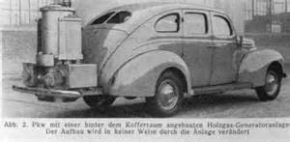
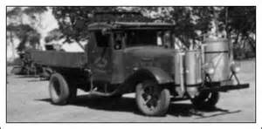
Bio Energy Application
Vehicle fuel
(using CNG Kit)
Notes:
In olden times biogas was used to drive automobiles.

Slide 25
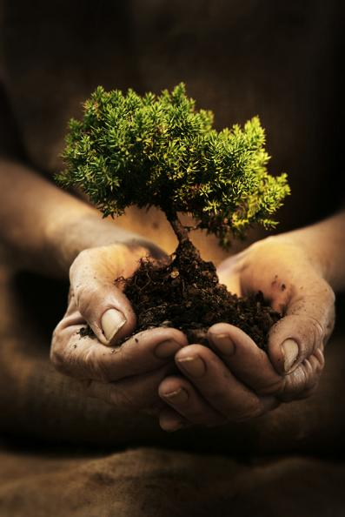
The solid (8 to 10% of input) and liquid
by-products
are nutrient rich and can be used as manure

Slide 26
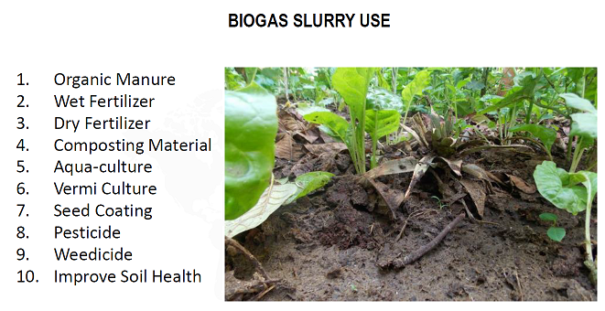

Slide 27
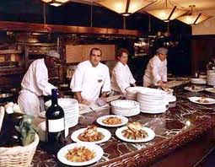
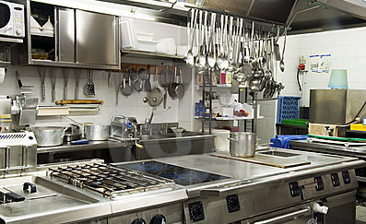
Available in standard sizes.
Custom engineered for large sizes.
Ideal for Condominium, Hotel, Canteen, Cafeteria and Community Kitchen.
Notes:
Biogas plant is available in standard sizes to handle 50 kg to 2,000 kg/day in HDPE and custom engineered for larger capacity from 1 TPD to 100 TPD

Slide 28
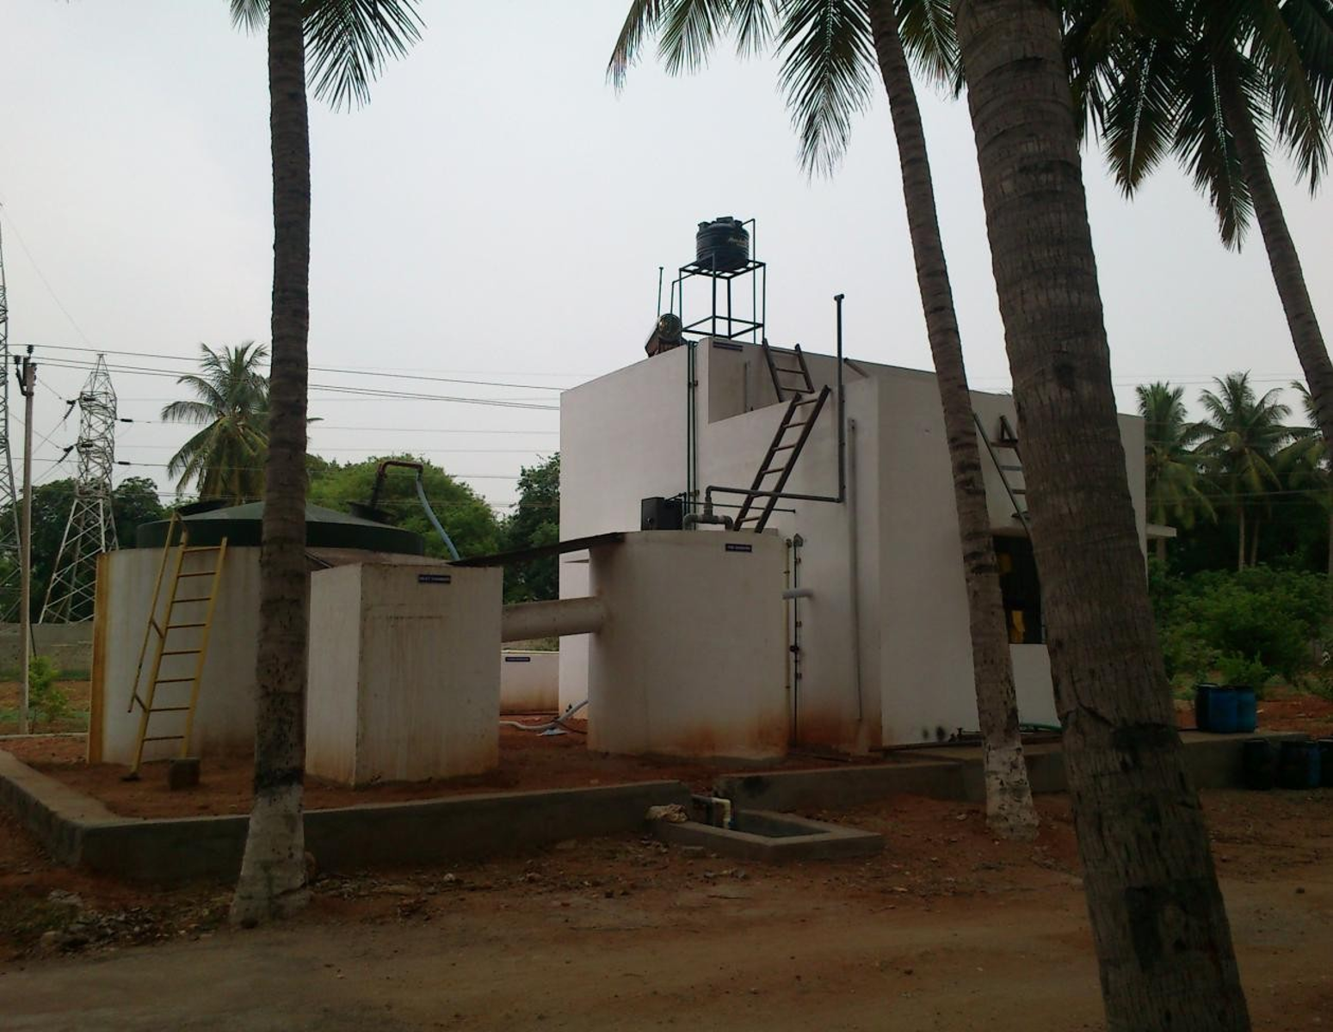
TNPL Kitchen, Food waste to Energy Plant - 500 Kg/day

Slide 29
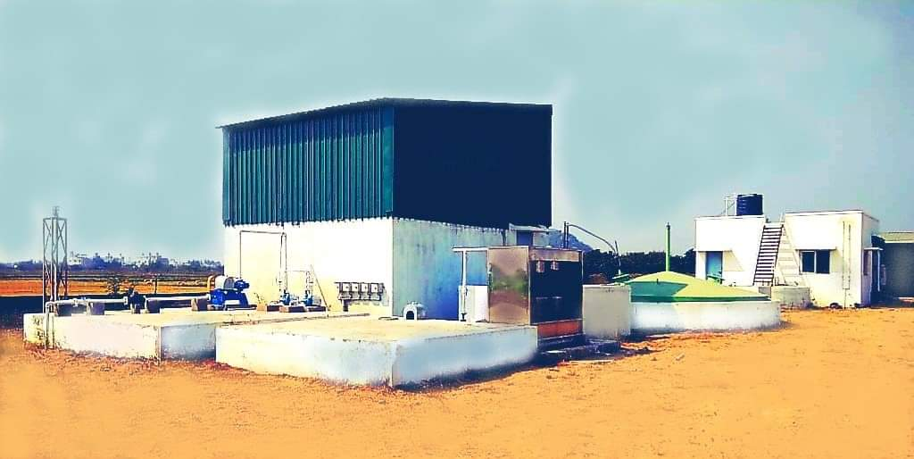
SSM Builders Kitchen, Food waste to Energy Plant - 3 TPD

Slide 30
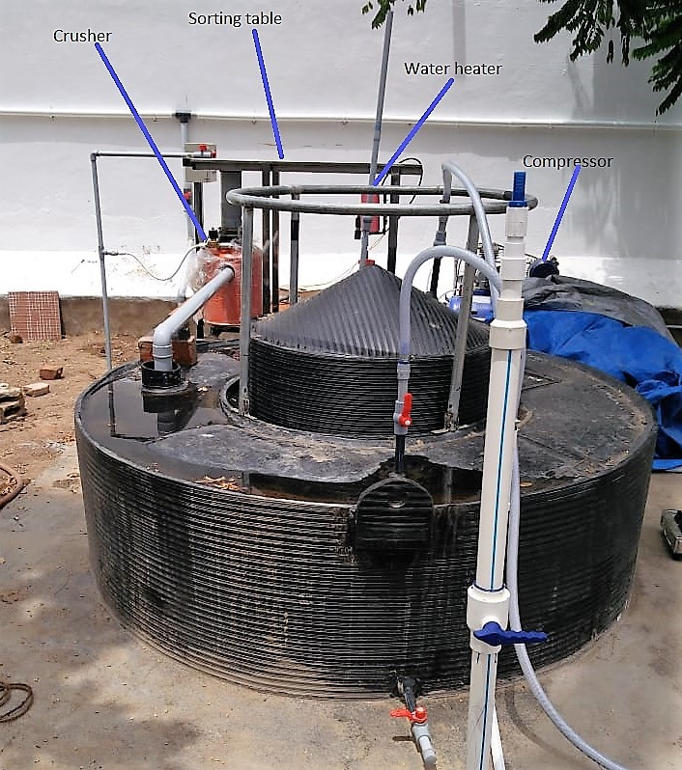
Typical Layout for 100/200/500 kg plant

Slide 31
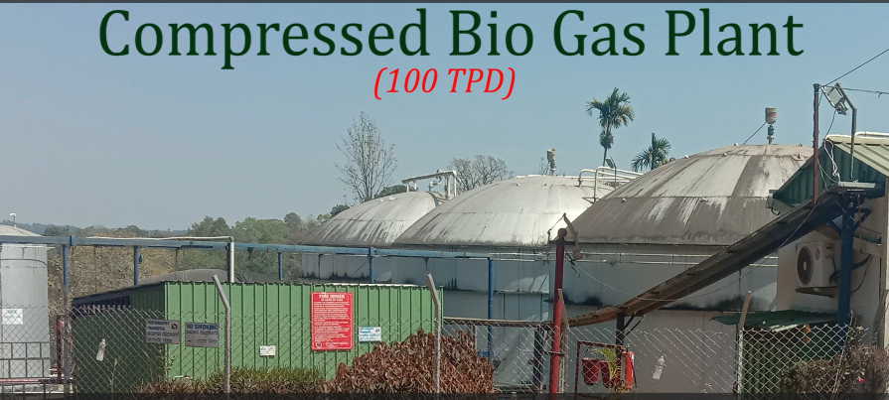
BBTC Kodagu District, Karnataka

Slide 32
Ideal Technology for secondary and tertiary treatment of:
Municipal Waste Water
Sludge management
Treatment of Industrial Effluent Agricultural Effluent
landfill leachates
Kitchen, Food, Plant, Animal & Human Waste.

Slide 33

The plant can be constructed underground without space wastage
Environment friendly since the process does not generate any polluting liquids or gas
Simple to operate
Almost zero maintenance
Notes:
Compact size biogas plants can be set up in small areas to handle biodegradable waste from the community. Waste can thus be processed at source without the need for transporting or dummping space in a most environmental friendly way and zero pollution.

Slide 34
Proven Technology
practically sound
eco-friendly
maintenance free
cost-effective
No electricity needed
minimum maintenance
self-sustainable
Aesthetic appeal
No mosquitoes no odor

Slide 35
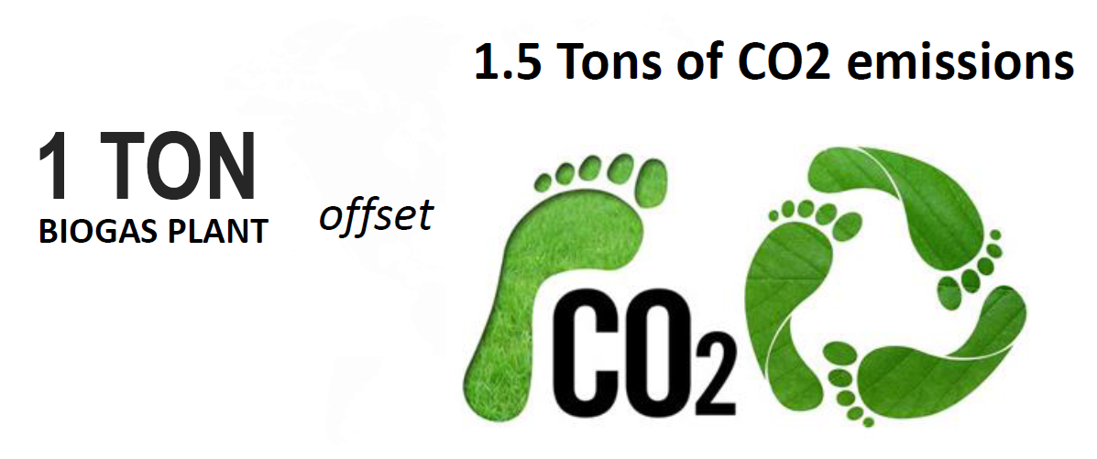

Slide 36


Slide 37


Cell: +91 9566057273/ Divakar
email: saynotofossils@gmail.com

